Slide 1
The international drug debate: What’s going on? Our challenges? What are our plans? Dag Endal FORUT and Drug Policy Futures

Slide 3
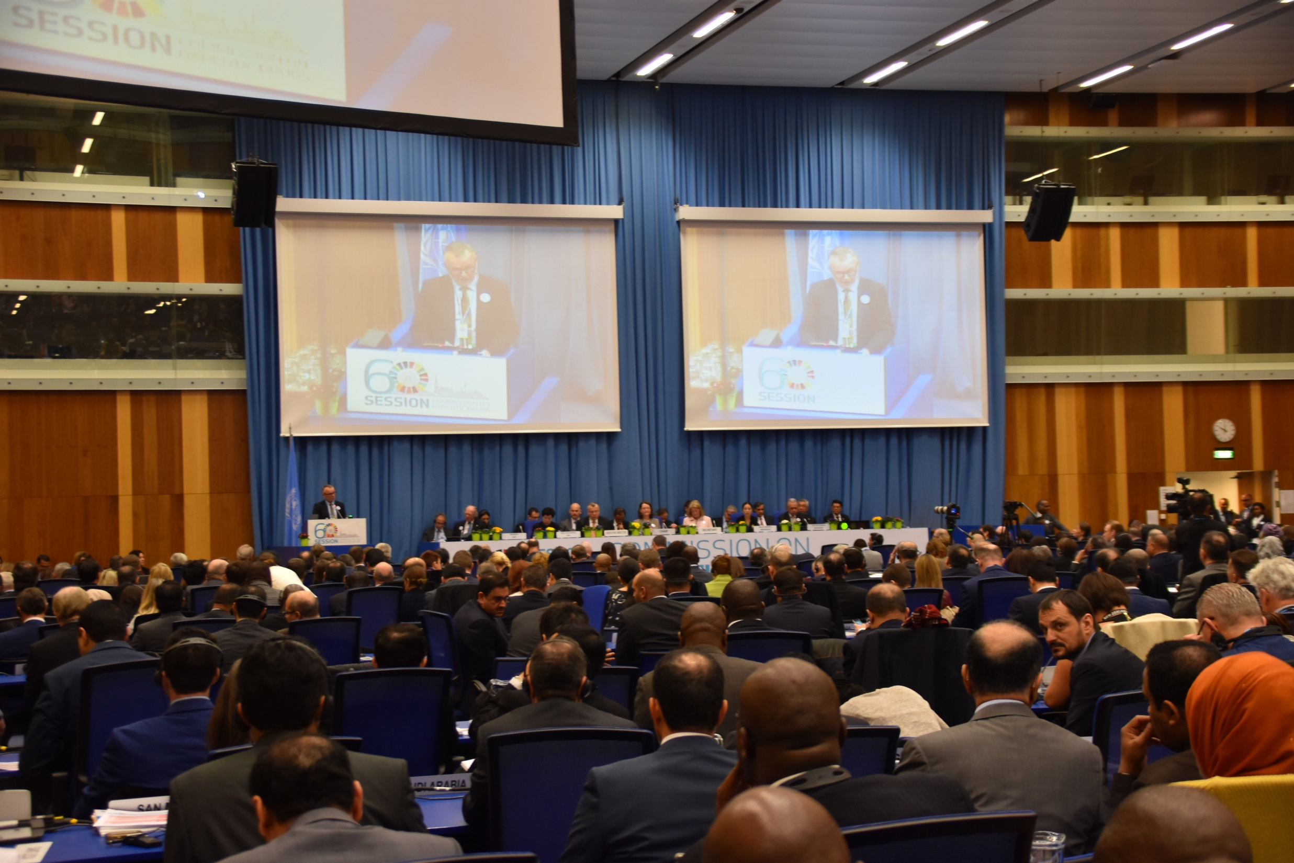
Commission on Narcotic Drugs (CND)

Slide 4
Prevent. Don’t Promote.

Slide 5
Drug policy timeline:
2009-2019: Action Plan
2016: UNGASS and the UNGASS Outcome Document
2019: High-level meeting and Ministerial Declaration
2019-2029: Implementation

Slide 6
A propaganda campaign to make narcotic drugs just as accepted and widely used as alcohol is today
The war for drugs:

Slide 7
The war for drugs:
Global
Well planned and designed
Extremely well funded
Well organized
…but also improvised
The manual is American

Slide 8
The war for drugs manual:
Legalization
Commercialization
Normalization
Glorification

Slide 9
Challenge the narrative:
A mercyless war against people and drug users
Everything has been tried
Everything has failed
Drugs policies are dangerous, not drugs themselves
Choice: A failed war or successful legalization?

Slide 10
Our narrative:
We know a lot about what works
That knowledge has to be used
The problem is not failed action, but too wrong actions and too weak actions
A third way – a middle way – exists
A broad, balanced and evidence-based strategy with prevention, early intervention, treatment, recovery etc.

Slide 12
Role of NGOs internationally:
Voices of the silent majority
Defend the UN conventions
Broad and balanced policies
Action. Now.
Advocate for improvements

Slide 13
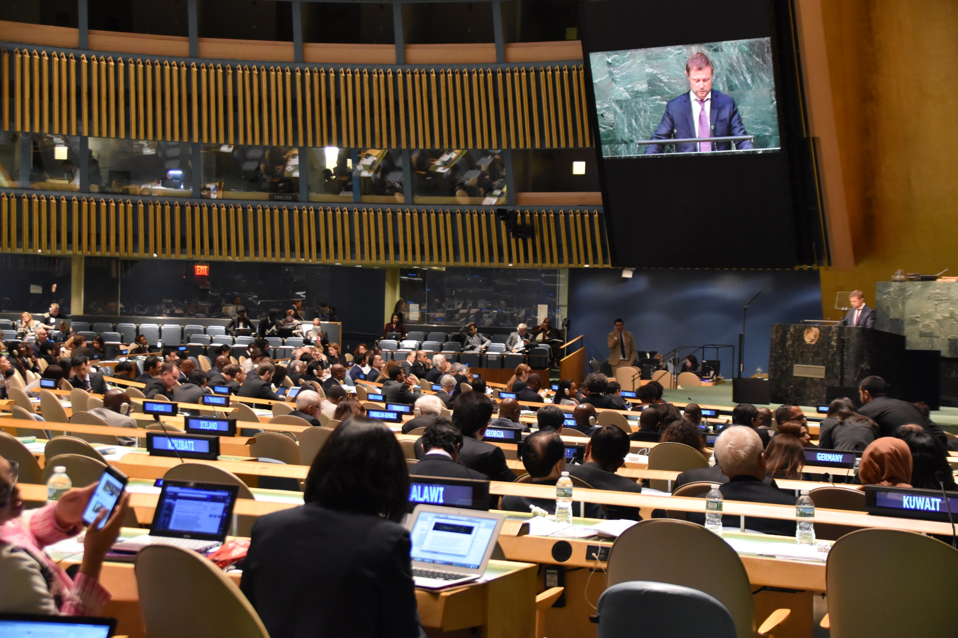
2016: UNGASS

Slide 14
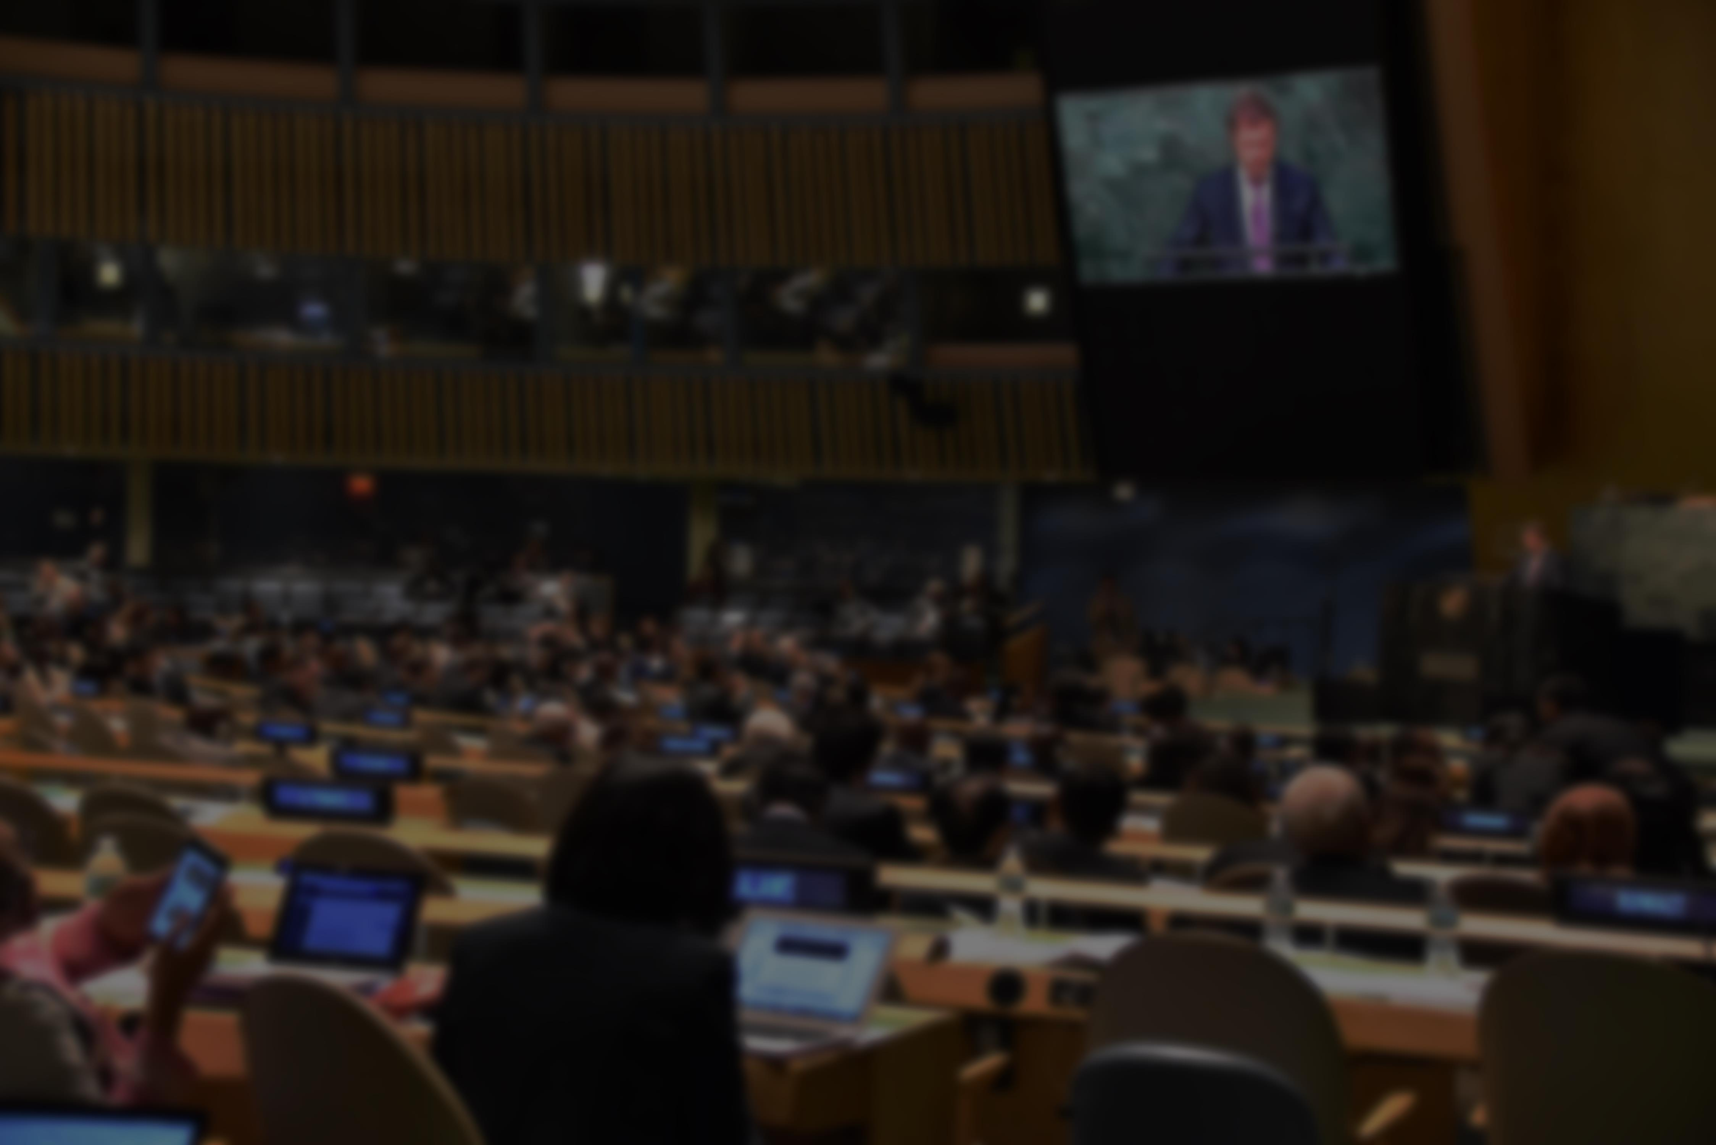
UNGASS
Outcome Document
A comprehensive menu for a broad, balanced and effective drug policy,
based on public health, human rights
and the three international drug conventions

Slide 15
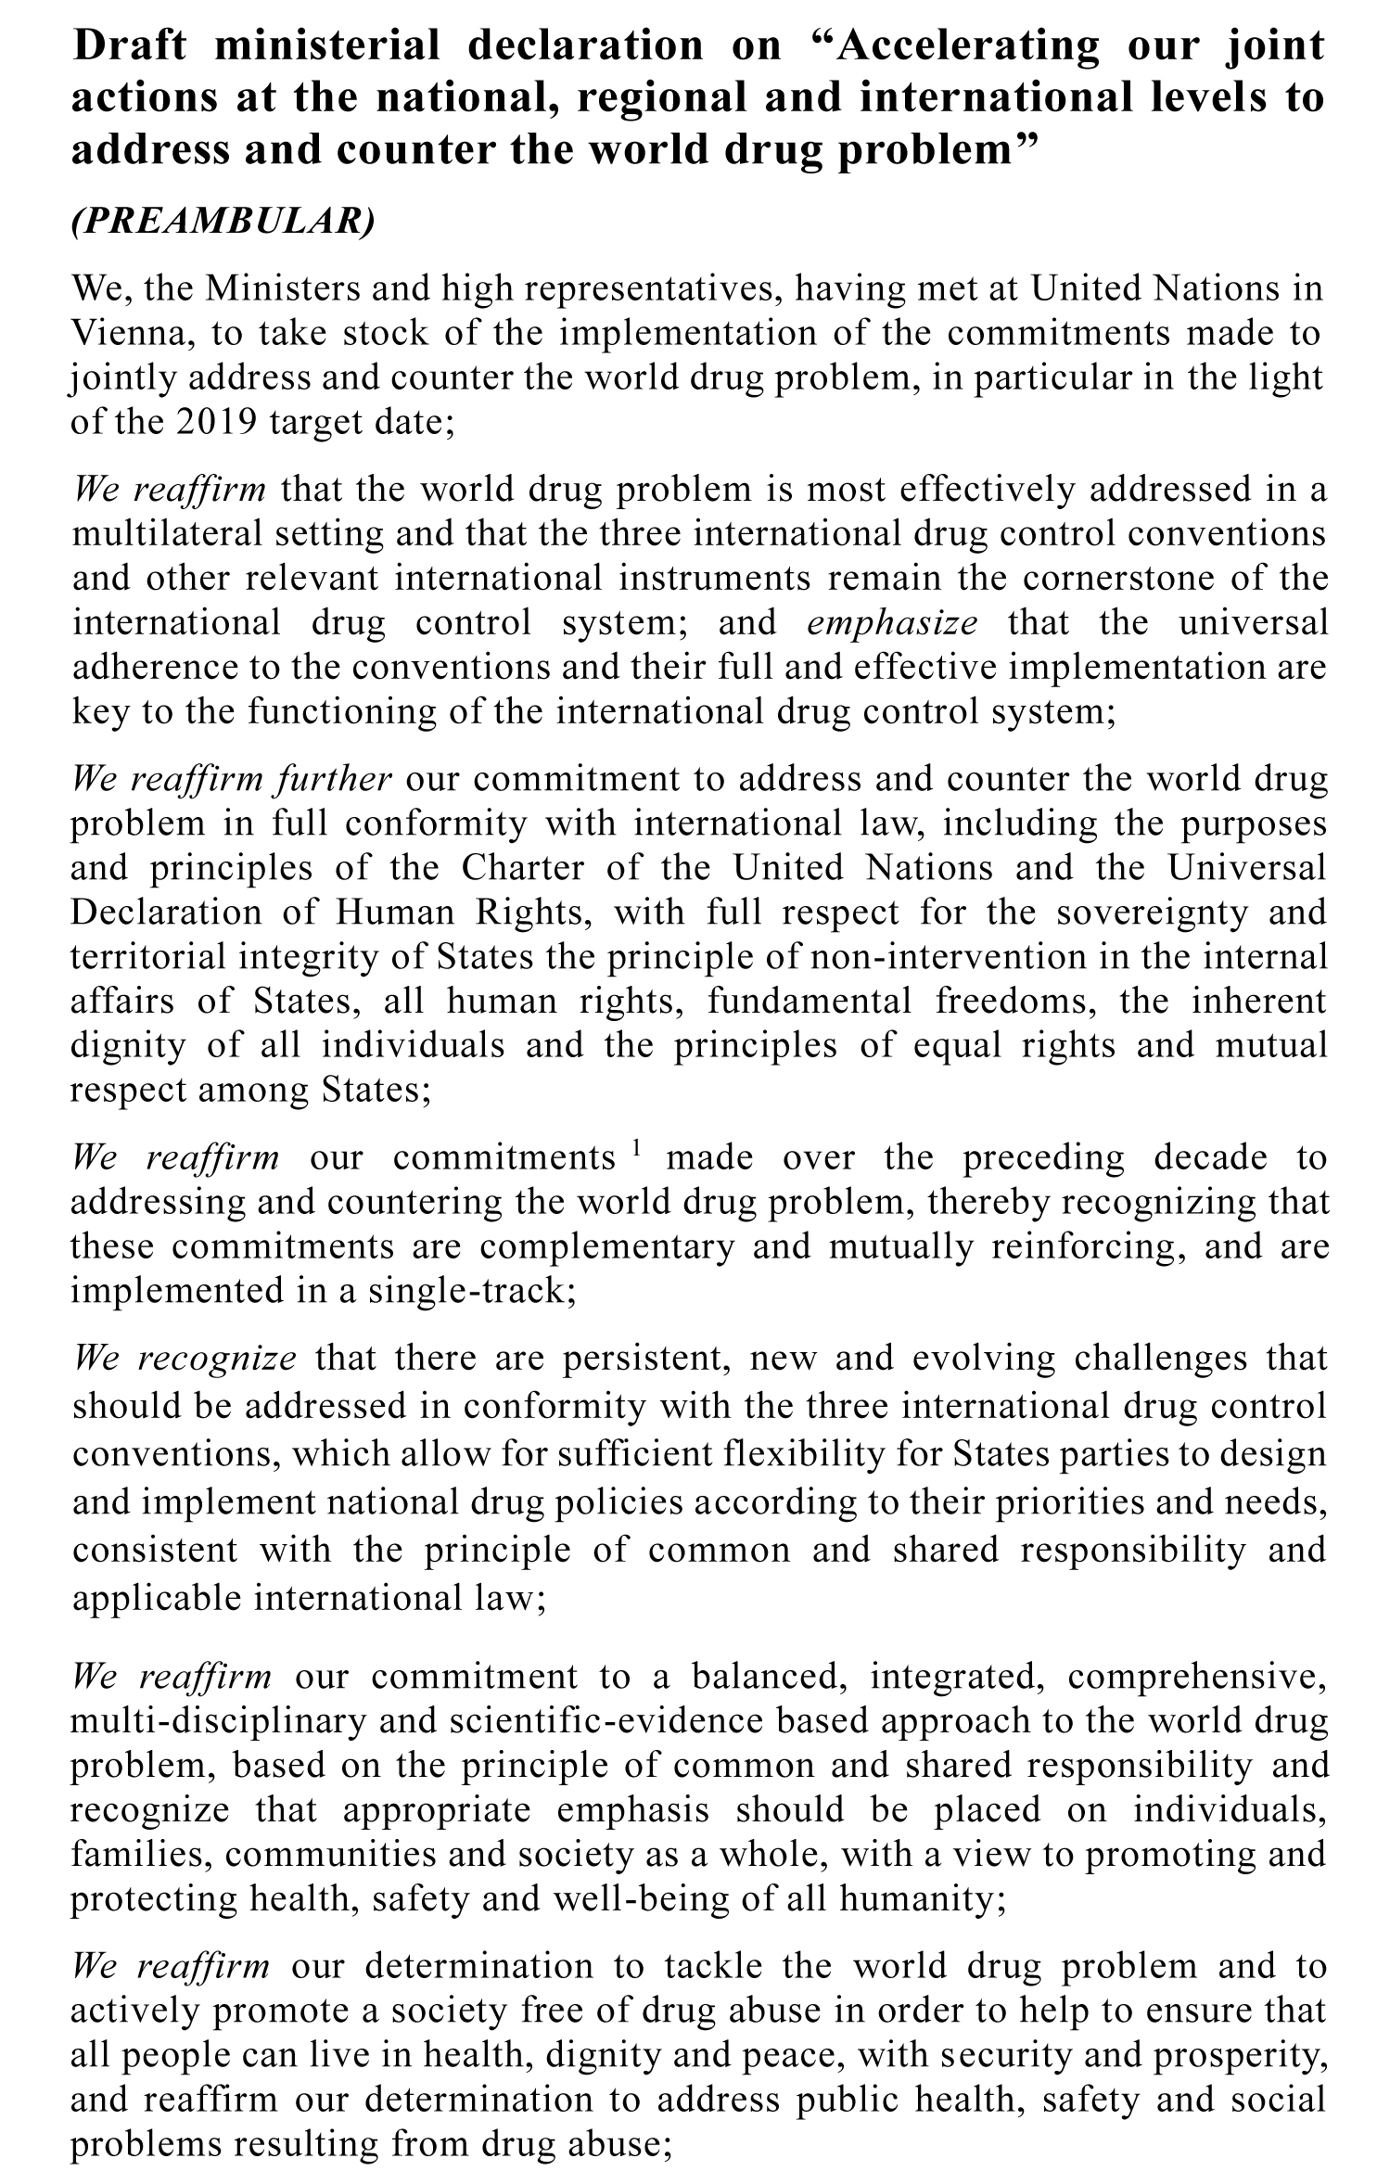
High-level
Meeting
March 2019
Ministerial Declaration

Slide 16
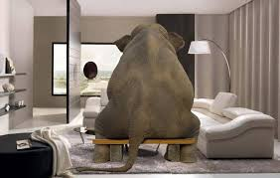
The framework:
TEN YEARS OF
NATIONAL IMPLEMENTATION

Slide 17
DPF regorganized:
Still a loose network
Still a slim structure
Focus on Vienna and CND
No competition with members
New: Operating Partners

Slide 18
DPF strategy next two years:
Foothold in Vienna
Regular lobby visits to Vienna
Recruit and train spokespersons
Two DPF meetings yearly
Share good examples
Stronger presence in VNGOC

Slide 19
CND; 2-6 March 2020:
Identify a lobbying message
Side-events and spesial event
DPF Luncheon
Exhibition
Report «Peoples’ Voice»
First Monitoring report?

Slide 20
Action.Now.

Slide 21
Prevent. Don’t Promote. Contact: dag@forut.no

